Slide 1

Climbing Sage
Find the best crags nearby

Slide 2
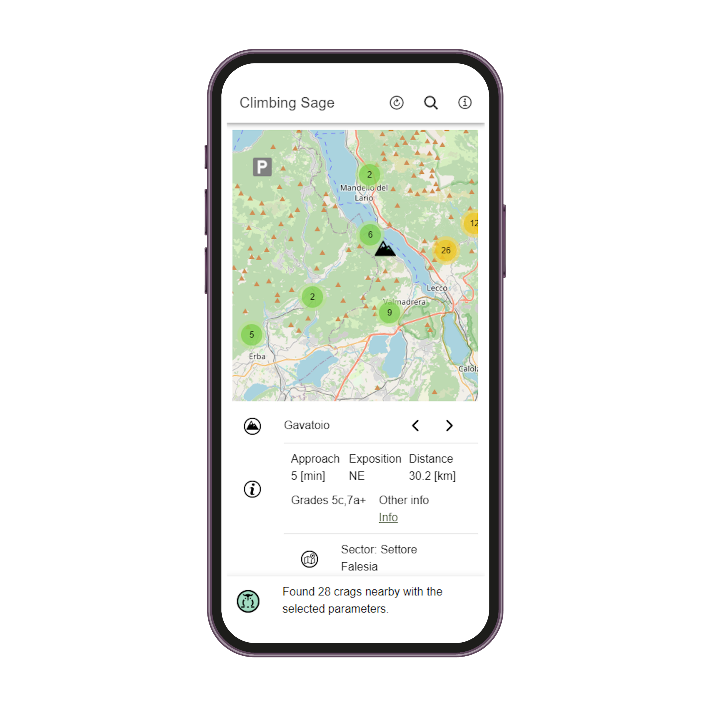
What is climbing sage?
As a sport climber, it's crucial to locate the ideal crags.
Climbing Sage will inquire about your desired difficulty level, preferred warm-up range, acceptable approach distance, desired sun exposure, and then search its database to identify the optimal climbing spot nearby your location.

Slide 3
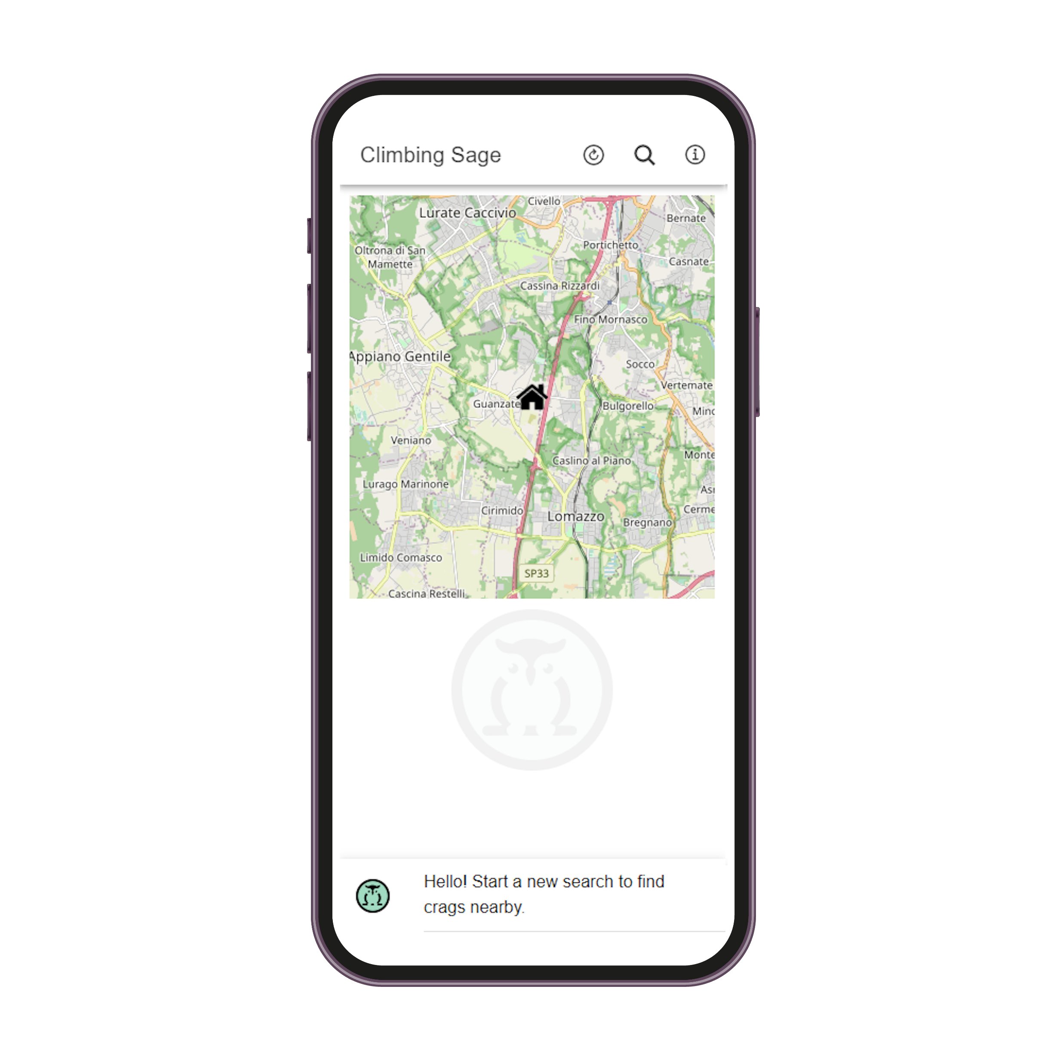
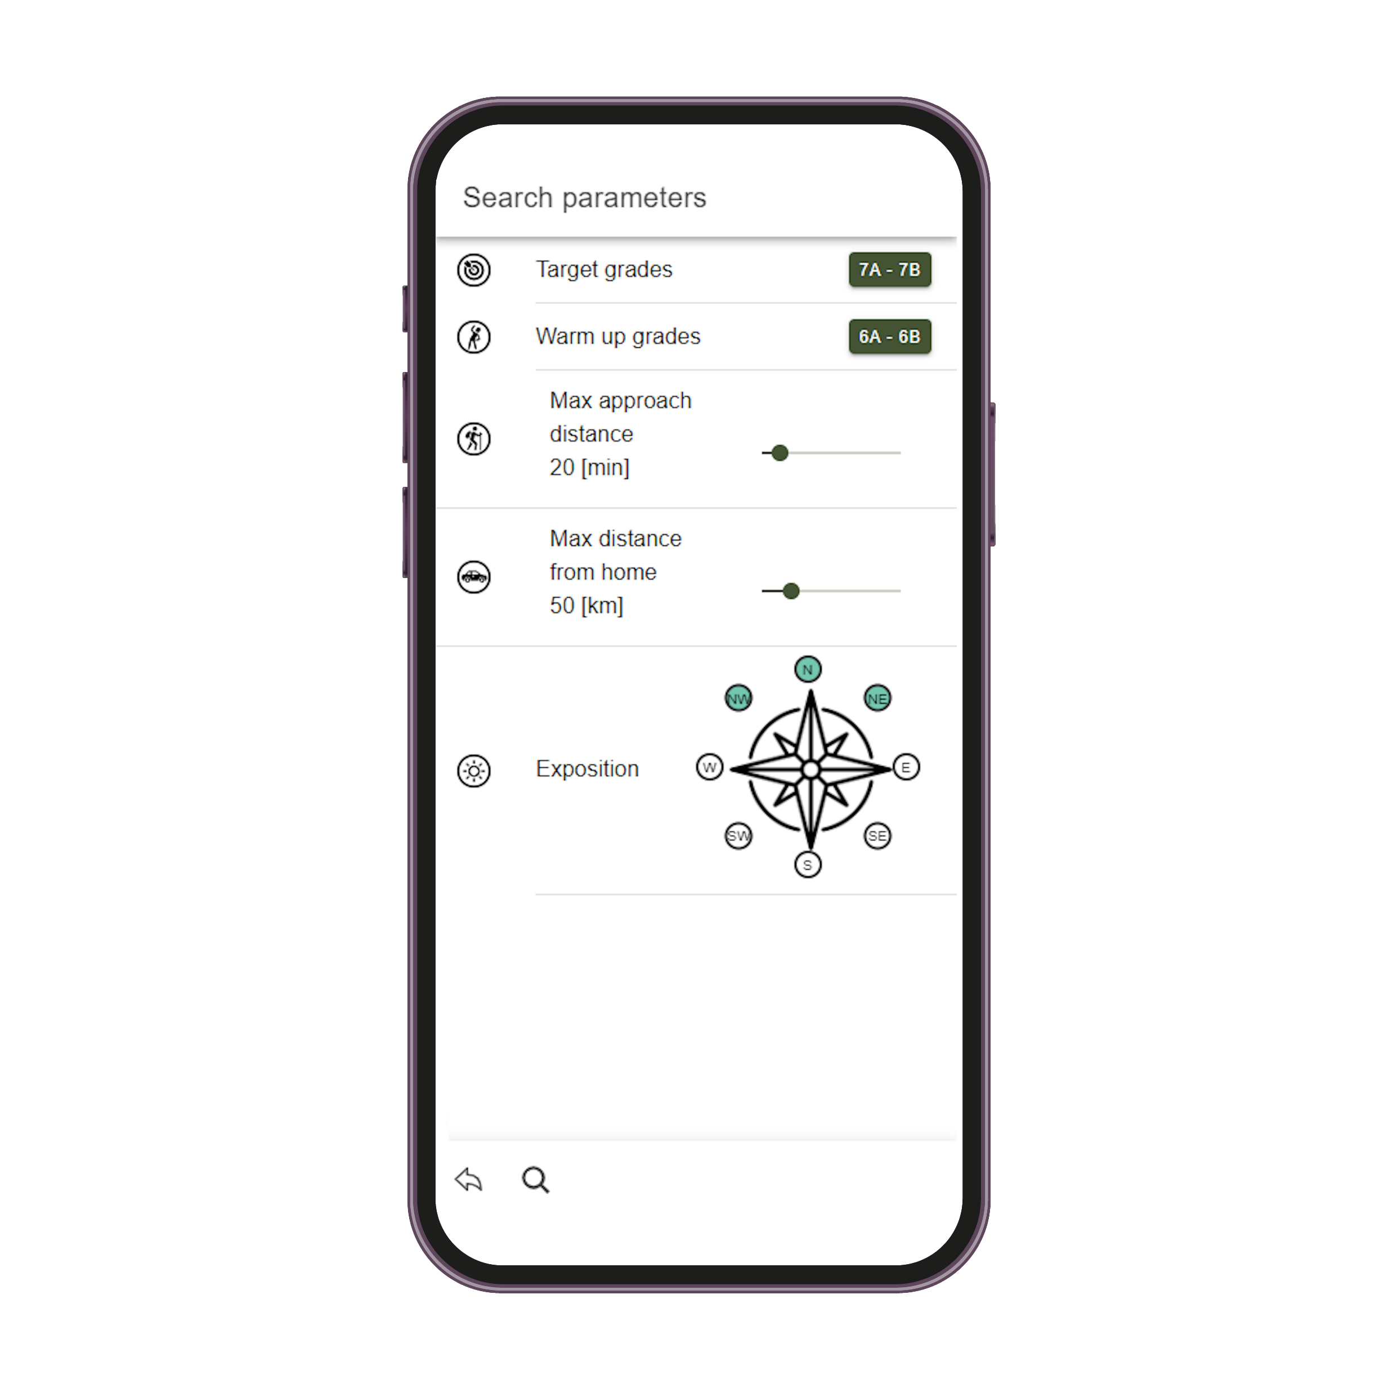
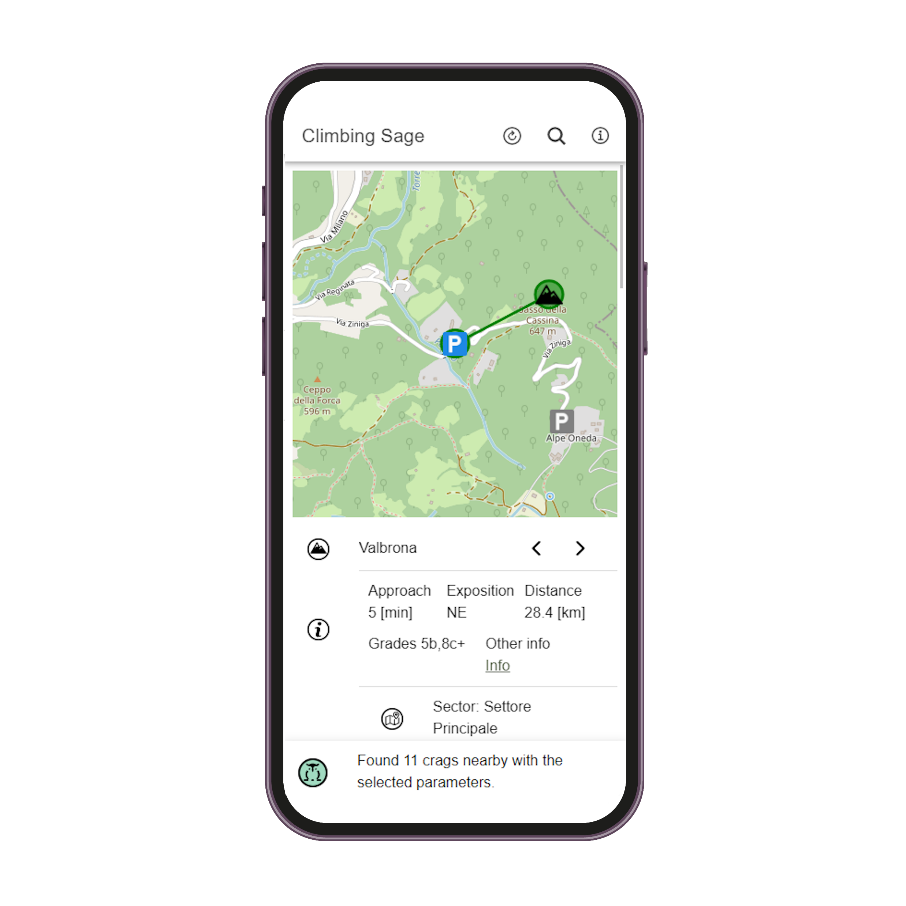
How does it work?
1
2
3
Climbing sage will identify your current location using the device’s GPS
Set the parameters to find your dream crag!
Browse the results

Slide 4







Tech stack
Back end
REST API
Python + Flask
Front end
Cross platform app (Web, iOS, Android)
Angular + Ionic + Capacitor
Deployment
Cloud
Docker + Google cloud run

